Slide 1
ACADEMIC PROJECT PRESENTATION (2023–2027)
STUDENT DETAILS
Student Name:
Kapilesh Saami Nagesh
(RA2311003050255)
Department:
CSE CORE
College Name:
SrmInstitute of Science Technology
Academic Year:
2023–2027
CampusLoop
Employee Leave Management System
Web-Based Employee Leave Management & Approval Platform
React.js | Spring Boot | MySQL | REST API | Playwright
Slide 1 / 10

Slide 2
CAMPUSLOOP PRESENTATION
Problem Statement
TRADITIONAL LEAVE MANAGEMENT
• Manual paper-based leave applications
• Informal & unorganized approval workflows
• Difficulty tracking real-time leave balances
• Lack of centralized employee record-keeping
• Delayed manager responses & approval bottlenecks
• Limited visibility of application status for employees
• Increased risk of data-entry & accounting errors
CORE PROBLEM DEFINITION
Employees and managers require a centralized digital web platform where leave requests can be submitted, tracked, reviewed, and approved efficiently without administrative friction.
Traditional Flow (Flawed): Employee ➔ Manual Paper Form ➔ Manager Desk ➔ Delayed Approval ➔ Manual Records
2 / 10

Slide 3
CAMPUSLOOP PRESENTATION
Proposed Solution
CampusLoop is a web-based employee leave management system designed to digitize, automate, and simplify the complete organizational leave workflow.
KEY SOLUTION ADVANTAGES
✔ Secure Employee & Manager Authentication
✔ Interactive Employee Dashboard with Leave History
✔ Online Application Submission with Instant Validation
✔ Real-Time Leave Balance Calculation & Tracking
✔ Streamlined Manager Approval / Rejection Portal
✔ Transparent Live Status Tracking for Employees
✔ Centralized MySQL Relational Database Persistence
✔ Robust RESTful Backend APIs built with Spring Boot
DIGITAL WORKFLOW
1. Employee Login
↓
2. Apply Leave Online
↓
3. Manager Review
↓
4. Approve / Reject
↓
5. Updated Status Sync
3 / 10

Slide 4
CAMPUSLOOP PRESENTATION
Key Features
👤 EMPLOYEE FEATURES
• Secure User Authentication
• Personalized Dashboard
• Real-Time Leave Balances
• Online Leave Application
• Comprehensive Leave History
• Track Live Approval Status
👔 MANAGER FEATURES
• View All Pending Requests
• Review Detailed Applications
• One-Click Approve / Reject
• Add Manager Comments
• Monitor Department Leaves
• Employee Audit Trail
⚙️ SYSTEM FEATURES
• REST API Architecture
• MySQL Relational Database
• Robust Error Handling
• Strict Input API Validation
• Playwright E2E Testing
• CORS & Security Config
4 / 10

Slide 5
CAMPUSLOOP PRESENTATION
System Architecture
CAMPUSLOOP HIGH-LEVEL ARCHITECTURE
REACT FRONTEND (Client Layer)
• React.js (JSX)
• Vite Build Tool
• React Router
• Auth Context
• Dashboard & Forms
SPRING BOOT BACKEND (Business Logic)
• REST Controllers
• Service Layer
• Repository Layer
• Spring Security
• DTOs & Validation
MYSQL DB (Persistence)
• User Table
• Employee Table
• LeaveRequest Table
• Relational Keys
⇄ REST APIs
⇄ JPA / JDBC
Architecture Summary: The React frontend communicates with Spring Boot REST APIs, which process business logic and persist employee & leave information in MySQL. API quality is verified using Postman and Playwright.
5 / 10

Slide 6
CAMPUSLOOP PRESENTATION
Employee → Manager Leave Workflow
STEP 1
Employee Login
Employee authenticates using secure email and password.
STEP 2
Apply Leave
Selects Leave Type, Start/End Dates, Number of Days & Reason.
STEP 3
Request Stored
Leave request is persisted in MySQL database with PENDING status.
STEP 4
Manager Reviews
Manager views pending leave requests in their portal.
STEP 5
Manager Decision
Manager evaluates the request and selects APPROVE or REJECT.
STEP 6
Status Updated
Employee views updated status and updated balance on dashboard.
6 / 10

Slide 7
CAMPUSLOOP PRESENTATION
AI-Assisted Development
AI ACCELERATION & DEVELOPER VALIDATION
• Assisted in generating and refining boilerplate code
• Accelerated Spring Boot API controller & service layer debugging
• Assisted with React UI component layout & state management
• Helped identify and resolve CORS & API integration issues
• Assisted in creating comprehensive test scenarios
• Helped optimize backend error handling and validation logic
• Supported Playwright end-to-end test automation setup
• Developer reviewed, modified, and validated all generated code
DEVELOPMENT WORKFLOW
[1] Developer Intent
[2] AI Assistance Prompt
[3] Code Generation
[4] Manual Debug & Refine
[5] Validation & Testing
Note: AI tools were used purely as development assistance. All application logic, schema, and API integrations were thoroughly verified and tested by the developer.
7 / 10

Slide 8
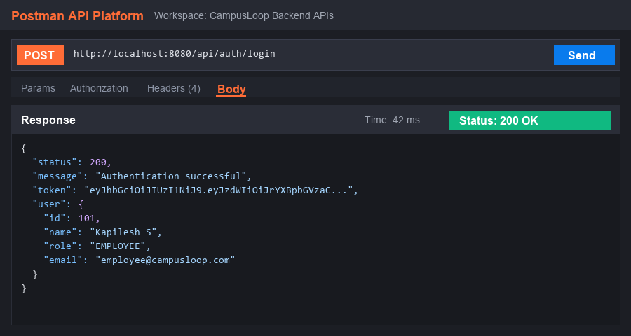
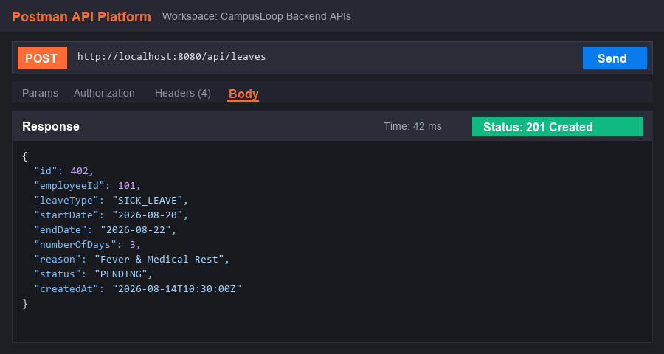
CAMPUSLOOP PRESENTATION
API Testing & Test Automation
VALIDATED REST API ENDPOINTS
POST /api/auth/login
Purpose: Employee authentication & JWT session
POST /api/leaves
Purpose: Create a new leave request
GET /api/leaves
Purpose: Retrieve all leave applications
GET /api/leaves/employee/{id}
Purpose: Retrieve employee specific history
PUT /api/leaves/{id}/status
Purpose: Update leave status (Approve/Reject)
8 / 10

Slide 9
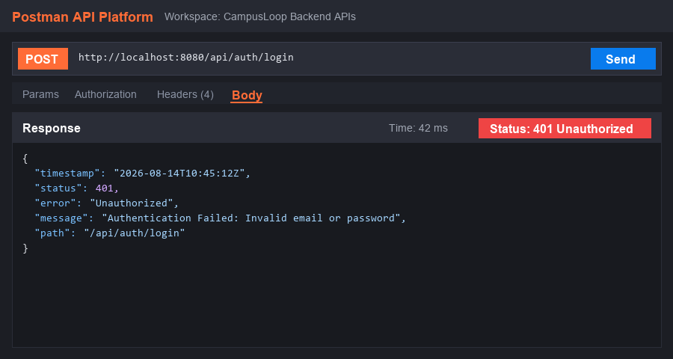
CAMPUSLOOP PRESENTATION
Test Validation: Failure → Fix → Pass
🔴 1. DELIBERATE FAILURE
Login tested with wrong password.
Result: 401 Unauthorized 'Invalid email or password'
🛠 2. FIX
Correct employee credentials provided.
Action: Request payload updated & re-sent to /api/auth/login
🟢 3. PASS
Valid authentication request.
Result: 200 OK 'Authentication successful'
9 / 10

Slide 10
CAMPUSLOOP PRESENTATION
Conclusion & Live Demo
PROJECT OUTCOMES
✔ Simplifies and digitizes employee leave application
✔ Reduces manual administrative paperwork and delays
✔ Provides transparent real-time status & leave balances
✔ Improves manager approval and decision workflow
✔ Robust Spring Boot REST architecture & MySQL persistence
✔ Validated with Playwright automated tests & Postman
LIVE DEMO FLOW
1. Employee Login & Dashboard
2. View Leave Balances
3. Submit New Leave Request
4. View Pending Application
5. Manager Reviews Request
6. Manager Approve / Reject Action
7. Employee View Updated Status
8. Demonstrate Postman API Validation
CampusLoop — Simplifying Employee Leave Management Through Technology
THANK YOU! | Q & A SESSION
10 / 10

